Slide 1
At Least the Graphs Look Pretty: A Reinforcement Learning Tale
Josh Cooper
CS 530 Principles of AI
Mid Semester Project Presentation
12/07/21

Slide 2
Project Description
Use Reinforcement Learning algorithms to create an agent capable of playing Minesweeper
Caveats:
Allow for clicking on mines and continuing to play
Overall score is based on average value of turns when mines were clicked

Slide 3
Scoring Explanation
Given a 3x3 board with 3 mines
The worst possible game would involve clicking a mine on turns 1,2 and 3
The best possible game would be turns 7,8,and 9
So the minimum score would be (1+2+3)/3 = 2
Max score would be (7+8+9)/3 = 8
For comparisons over board size I scale all scores and turn them into percents

Slide 4
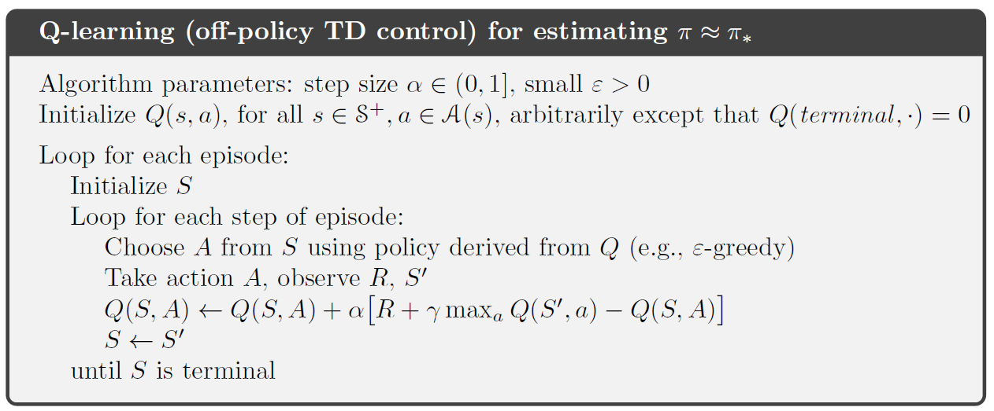
Algorithms Attempted (v1)
Q-Learning

Slide 5
Algorithms Attempted (v1)
Mine Location Prediction
Simply generate a large number of boards and mine solutions, and train a network to attempt to predict mine locations
This is technically supervised learning, but has proven simple and effective for generating good next action choices
Use the MLP network to attempt to generate board state transitions to allow for the Q network to have better training data (bootstrapping principles)

Slide 6
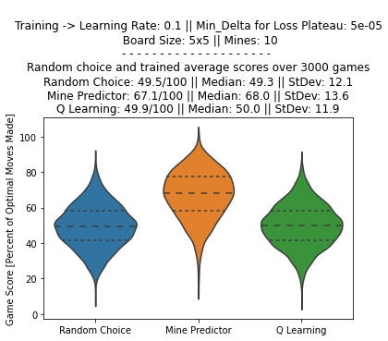
Using Mine Location Prediction to train the Q-learning Network
Current attempts involve using the MLP network to produce the training data for the Q network
Despite the relative accuracy of the MLP in producing optimal next steps, the Q-Learning network is having trouble learning the weights to produce effective estimates of expected returns for locations on the board

Slide 7
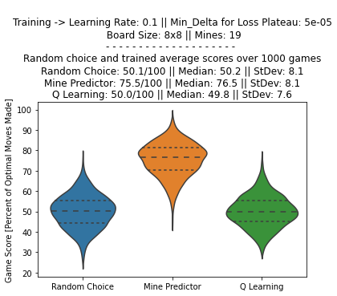
Board Size Considerations
Q Learning showed no mean change in accuracy, either positive or negative, when board size increased by a factor of ~2 (25 squares -> 64 squares)
The lower tails of the various predictions got smaller and closer to the medians, possibly due to the lower number of test games I allowed this test to play due to time considerations
Mine Prediction Network got better overall though!
That might have been due to lowering the percentage of mines on the board being decreased when I made the board bigger however.

Slide 8
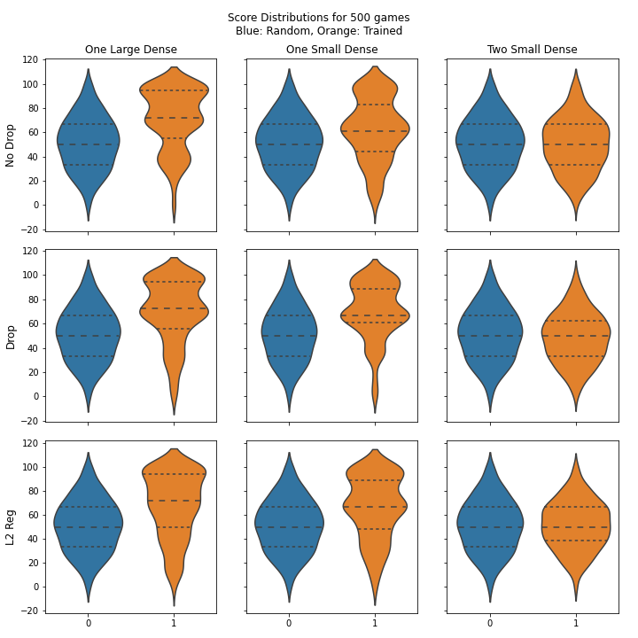
Network Shapes and Features
Testing over a variety of network hyperparameters to ID the best versions for producing outputs
TBH I just liked making the violin plots, they look really cool.

Slide 9
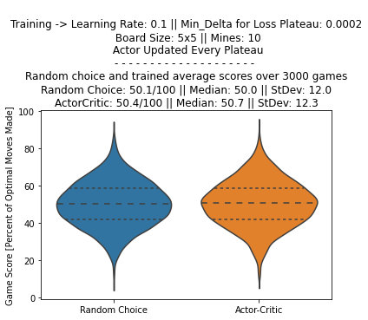
Actor-Critic Q-Learning
Next attempt involved using AC Q-learning to allow the network to try and learn distinct policies and then update its definitions over time
Attempted to have the network learn policies which ranged from pure random to pure greedy Q-Learning
Results were… less than ideal

Slide 10
Problems with my current approach
Q-Learning is guaranteed to converge!
State/Action Space is insanely huge
Under infinite trials and runs…
So real world limitations might be creeping into play here
NxM board would have an upper bound of 10^(NxM) states, and each state could have on average (NxM)/2 actions.
Randomly sampling this space to attempt to learn a policy is an immense undertaking.

Slide 11
Next Steps
Garbage In, Garbage Out
Policy Gradient Algorithm
Based on the training data being generated by a network, there is a chance it might be producing bad action choices and throwing off the Q Learning
How good are humans at minesweeper? Need to generate comparison data to see if model playing at 50% is a problem.
Whole new training algorithm
Will it suffer the same fate as regular Q or AC-Q?
Will I ever get viable data?
TUNE IN NEXT TIME!

